Slide 1
Navigating KISD Online
Training Superheroes
Presented By: Erin Mills and Jsanean Mark
Killeen ISD Parent Educators
Special Educators see the
Ability, not the Disability
Notes:
Discussion Points:
Beginning with the Continued Learning Center, we will walk through the important elements on the website. As we navigate through the links provided on the CLC, we will jump to the Students and Parents Link so that they can see how to access Clever as well as how to link multiple students to one Schoology account
(This is important as many people struggle accessing the programs and need an alternative way to do so / also many have multiple family members and need to know how to make it easier to access)
User names, passwords, etc.
I will walk them through using Aidan’s Account
If you’re willing, I’ll have you walk through how to link two kids under one schoology account

Slide 2
Our purpose: to identify and explore important resources for parents on KISD’s Website
Home Page Tab:
Continued Learning Center
https://www.killeenisd.org/elementary_continued_learning
https://www.killeenisd.org/secondary_continued_learning
Grab and Go Meals
Online Registration and Enrollment
Students and Parents Tab: resources for parents and students in a variety of user-friendly links for home use
Clever:
Schoology:
Directions for linking multiple students for Parents: https://www.killeenisd.org/sgyparents
Edgenuity
Home Access Center https://esphac.killeenisd.org/HomeAccess/Account/LogOn?ReturnUrl=%2fhomeaccess
Free Microsoft Office for Home Use- https://www.killeenisd.org/kisd_provides_free_ms_office
Schools Tab: access to your campus’s website including staff directories and events specific to the campus
Departments Tab:
Special Education https://www.killeenisd.org/special_education
Parent Educator Corner https://www.killeenisd.org/parent_educator_corner
Notes:
Discussion Points:
Beginning with the Continued Learning Center, we will walk through the important elements on the website. As we navigate through the links provided on the CLC, we will jump to the Students and Parents Link so that they can see how to access Clever as well as how to link multiple students to one Schoology account
(This is important as many people struggle accessing the programs and need an alternative way to do so / also many have multiple family members and need to know how to make it easier to access)
I will walk them through using Aidan’s Account
If you’re willing, I’ll have you walk through how to link two kids under one schoology account
Grab and Go Meals
Online Registration
Special Education Website and important areas of information
Parent Educator Corner- Resources, TEA links, continuous updates

Slide 3
What Do I Do?
We don’t want anyone to feel like this…
So before you begin to feel like this…
This Photo by Unknown Author is licensed under CC BY-NC-ND

Slide 4
504 and Dyslexia
Michelle Oswalt
At-Risk, Sec. 504, Dyslexia, GEH Specialist - Elementary
Christina Walker
At-Risk, Sec. 504, Dyslexia, GEH Specialist – Secondary
Notes:
Who to contact: I know there have been many changes to who is covering which campus. I am sending an email to see if this can be updated asap by the coordinators. ☺
Also express the importance of reaching out to teacher directly and to campus facilitator (for SPED and 504)

Slide 5
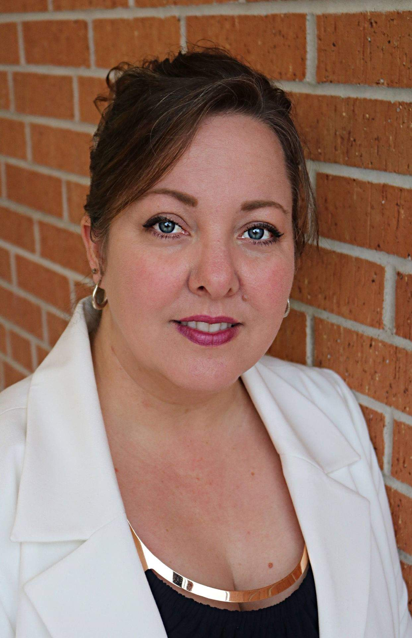
KISD District Transitions Specialist
Tina Capito
KISD District Transition Specialist
Notes:
Who to contact: I know there have been many changes to who is covering which campus. I am sending an email to see if this can be updated asap by the coordinators. ☺
Also express the importance of reaching out to teacher directly and to campus facilitator (for SPED and 504)

Slide 6
Our Special Education District Administrators
Left Row:
Laura Dunnells
Special Education Coordinator
Campuses: Killeen High School, Liberty Hill Middle School, Patterson Middle School, Smith Middle School, Cedar Valley Elementary School, A. Douse Elementary School, Haynes Elementary School, Timber Ridge Elementary School, Fowler Elementary School
Cecilla Smith
Special Education Coordinator
Campuses: Career Center, Gateway High School, Nolan Middle School, Gateway Middle School, Bellaire Elementary, Clarke Elementary, Clifton Park Elementary, Meadows Elementary, Montague Village Elementary, Reeces Creek Elementary, Pershing Park Elementary School, West Ward Elementary School
Dr. Jacqueline Pilkey
Special Education Director
Right Row:
Dr. Janice Peronto
Special Education Executive Director
Malcolm Mahoney
Special Education Coordinator
Campuses:
Harker Heights High School, Eastern Hills Middle School, Union Grove Middle School, Cavazos Elementary, Harker Heights Elementary, Mountain View Elementary, Nolanville Elementary, Skipcha Elementary, Maude Moore Elementary School, Sugar Loaf Elementary School
Rodney ‘Jack; Ivey
Coordinator Sped Data Management System
Center Row: Joshua DeLoach- Special Education Coordinator Campuses:
Kevin Lanxon- Special Education Coordinator Campuses:
Randy Carder- Special Education Coordinator Campuses:
Pathways Academic Campus, Early College High School, Audie Murphy Middle School, Clear Creek Elementary, Maxdale Elementary, Trimmier Elementary, Oveta Culp Hobby Elementary, Venable Village Elementary, Early Childhood Intervention (KECAT)
Shoemaker High School, Live Oak Ridge Middle School, Iduma Elementary, Willow Springs Elementary
Ellison High School, Palo Alto Middle School, Manor Middle School, Rancier Middle School, Brookhaven Elementary School, Hay Branch Elementary, Ira Cross Elementary, Peebles Elementary, Saegert Elementary, Metroplex Pavilion
Notes:
Who to contact: I know there have been many changes to who is covering which campus. I am sending an email to see if this can be updated asap by the coordinators. ☺
Also express the importance of reaching out to teacher directly and to campus facilitator (for SPED and 504)

Slide 7
Special Education Parent Educators
Jsanean Mark
Campuses: Shoemaker and Ellison High School and all Elementary and Middle Schools in the campus feeding patterns
Erin Mills
Campuses: Killeen and Harker Heights High School and all Elementary and Middle Schools in the campus feeding patterns
Notes:
Who to contact: I know there have been many changes to who is covering which campus. I am sending an email to see if this can be updated asap by the coordinators. ☺
Also express the importance of reaching out to teacher directly and to campus facilitator (for SPED and 504)

